Slide 1
Supercomputer Centers and Electricity Service Providers: Europe and the United States
Energy Efficient HPC Working Group
Demand Response Team
Notes:
Hello my friends in Stockholm. I wish I were there with you in person, but thought that I would offer this opportunity for me to participate virtually. Many of you have participated in the Energy Efficient HPC Working Group’s Demand Response team in our exploratory work to understand the emerging relationships between supercomputing centers and their electricity service providers. This presentation is a report on your work with that team. I am hoping that it compliments your agenda at the 6th European workshop on HPC centre infrastructures. I think your agenda includes a look “at the demands on the power grid that are special for HPC centres like ultra fast power swings”. I am particularly interested in the results of that session- perhaps you could record it or redo it as a webinar for the EE HPC WG? In any case, I think that what I have to tell you with this presentation will be worth listening to as part of that discussion.

Slide 2
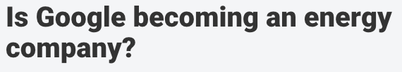





Google’s Relationship
Perhaps more of a merger or take-over than a mutual relationship
Notes:
I’d like to start by providing a context with a brief look at Google’s special relationship with the power grid. Innuendo has it that Google may be your next electricity provider.
(Note: Welcome to Utility Dive. Our mission is to provide busy professionals like you with a bird's-eye-view of the Utilities industry in 60 seconds.)

Slide 3
Google- An Energy Company? Some Facts…
Clean energy
US$2B investment worldwide, various technologies
Google Energy Subsidiary
granted the right to sell energy
Consumer smart-grid products
US$3.2B Nest Labs investment in smart thermostat
Grid infrastructure investment
37% stake in high-voltage direct-current transmission path for 7GW offshore wind power
Electric utility products
General Electric partnership merges Google Maps into electric utility geospatial analytics tools and software
Broad spectrum and substantial investments
Multiple sources 2014-2015
Notes:
Here are some of the facts.

Slide 4
Investing in Energy R&D
Set ‘game changer’ R&D strategy
Combating climate change exclusively with today’s renewable energy technologies simply won’t work
Cancelled RE<C, cheap renewable energy R&D program
Need something disruptive; "dispatchable" (can be turned on and off), "distributed" (produced near where it's wanted) - at costs well below coal or gas
Hired former head of US DOE ARPA-E Blue Sky
Hiring electrical power engineers
Filing related patents
Long-term energy commitment
http://spectrum.ieee.org/energy/renewables/what-it-would-really-take-to-reverse-climate-change
http://www.bloomberg.com/news/articles/2014-06-10/google-said-to-plan-energy-push-with-tools-for-utilities
Notes:
Google has also been investing in energy R&D. They have relatively recently made a major shift in their energy R&D focus. In 2007, Google announced an initiative to develop renewable energy sources that would generate electricity more cheaply than coal-fired power plants do and to do it in years, not decades. This initiative was cancelled and Google’s R&D effort has shifted to looking for more innovative, disruptive, game changing technologies. They describe the technology requirements as dispatchable and distributed. There is an interesting article about this published in IEEE Spectrum by two of Google’s engineers who worked on the project. These technologies are being developed by Google’s Energy Access team led by Arun Majumdar, former head of the US Department of Energy’s ARPA-E blue-sky research program. Google has been hiring to support this research and has been filing patents in the area.

Slide 5
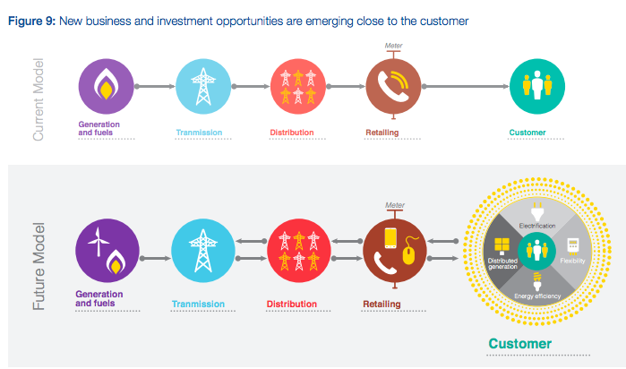
The Landscape is Changing
New opportunities may open up to innovators
World Economic Forum, Future of Electricity Report 2015
Notes:
Google is calling for energy innovation at Google speed. Clearly Google has high expectations for game changing R&D. It isn’t clear how those expectations will play out, but there is clearly a changing landscape for how electricity is generated, transmitted, distributed, marketed and used. What used to be a linear, one-way street is at least becoming bi-directional. This model may be over-simplified, but it is a good place to start for today’s conversation. Whether it is today or tomorrow, I think that you will be developing a tighter relationship with your electricity provider.

Slide 6

Thank you respondents!
Europe: LRZ, JSC, HLRS, CEA, EDF, ECMWF, CSCS, KTH, CINECA
Germany (3), France (2), United Kingdom, Switzerland, Sweden, Italy
United States: LLNL, NERSC, SDSC, NCSA, ANL, LANL, Intel, WPAFB, ORNL, NOAA, Purdue
California (3), Illinois (2), New Mexico (2), Ohio, Tennessee, West Virginia, Indiana
Notes:
As I mentioned at the beginning of this talk, many of you you have participated in the Energy Efficient HPC Working Group’s Demand Response team in our exploratory work to understand the emerging relationships between supercomputing centers and their electricity service providers. I’d like to recognize and thank the respondents. I hope you’ll see that your contribution has helped with this effort and I hope you’ll feel that the effort itself is worthwhile.
You’ll notice that these are sites whose supercomputers are large. We targeted participants on the Top50 List, as we felt their power draw and variability would be greatest and probably most interesting for this study.
(Notes:
JSC- Juelich Supercomputing Center
HLRS – High Performance Supercomputing Center of Stuttgart
ECMWF – European Center for Mid-Range Weather Forecasting, Reading UK
EDF – Electricite de France
NERSC – National Energy Research Scientific Computing Center)

Slide 7
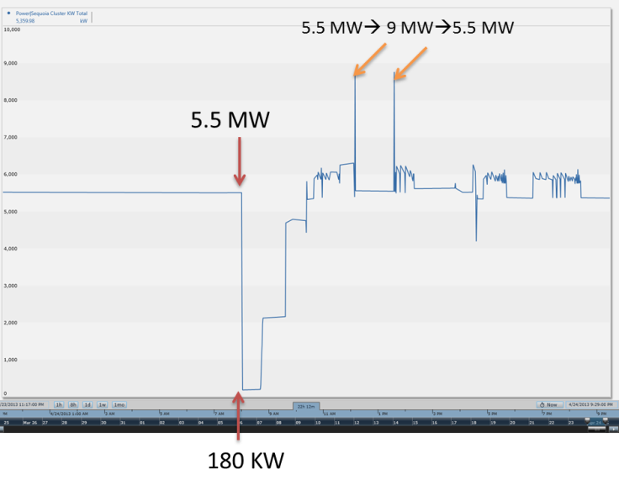
Investigative Analysis
A snapshot of Sequoia power profile at LLNL
Increasing power demands as well as instantaneous swings in power may require different relationships with electricity providers
Changing electricity grid may allow for new and beneficial opportunities
Energy savings (at least for the electricity grid)
Notes:
Now I’m going to dive into the investigative analysis. The EE HPC WG Demand Response Team was initiated when Anna Maria Bailey from Lawrence Livermore National Lab reported that her electricity provider called in alarm when LLNL ran Linpack for the first time on their Blue Gene Q Sequoia supercomputer. You can see from this picture that Sequoia power can vary by 9MW in a short period of time. Both increasing power demands as well as instantaneous swings in power may require different relationship with our electricity providers. Also, as your open-ended questions revealed, we are interested in how the changing electricity grid may allow for new and beneficial opportunities. Finally, tighter integration between supercomputing centers and electricity service providers can also yield energy savings, at least for the electricity grid.

Slide 8

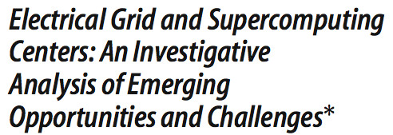
Initial Results and Next Steps
Conclusion: interest is there in the United States, but business case remains to be demonstrated
Next steps: look at other geographies where electricity is more expensive and subject to more variability with renewables → Europe
* Bates N, Ghatikar G, Abdulla G, Koenig G, Bhalachandra S, Sheikhalishahi M, Patki T, Rountree B, Poole S, "The Electrical Grid and Supercomputing Centers: An Investigative Analysis of Emerging Opportunities and Challenges". Energiinformatik 2014. Springer Publications. Zurich, Switerland 2014.
Notes:
We completed an analysis of supercomputing centers in the United States and published our results. We concluded that there is interest for tighter grid integration, but the business case remains to be demonstrated. We then decided to look at other geographies to see if there is a stronger business case where electricity is more expensive and subject to more variability with renewables. Europe and Japan were considered and we chose to investigate Europe first.

Slide 9
General Conclusions: US and Europe Comparison
Neither the US nor European sites are working with their electricity providers to respond to grid requests
The US sites have had more discussions with their providers about grid integration
There is no evidence that European sites are more interested in grid integration
Notes:
We discovered that neither the US nor Europe are currently working with their electricity provider with power management for grid control. Further, for reasons we haven’t fully understood, the US shows more interest than Europe in responding to request from their electricity providers. We hypothesize that this has to do with greater availability of electricity demand response incentive programs in the United States. We are now working on better understanding the European electricity providers and their environment to see if this hypothesis has merit.

Slide 10
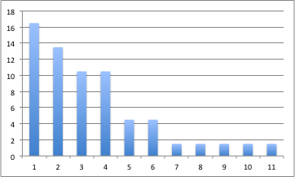

US and European Site Total Load
United States Site Total Load
Total Load (MW)
European Site Total Load
Sites
Most sites in both US and Europe have less than 5MW Total Load (16/20)
4 10+MW sites are much larger than all the others

Slide 11
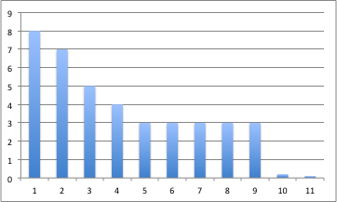
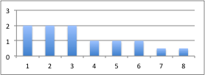
US and European Site Variability
United States Max Variability
Variability (MW)
Europe Max Variability
Sites
US lowest option = 'Less than 3MW’ (unless in comment)
Most sites in both US and Europe have less than 3MW variability (15/19)
4 sites in US much greater than all the others
Comments: Greatest source of variability is caused by maintenance events

Slide 12
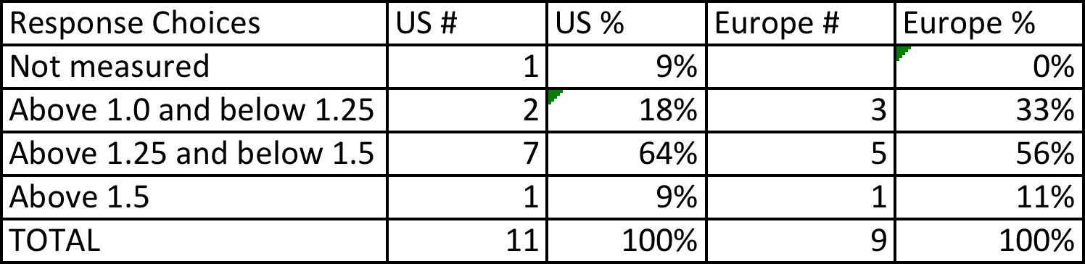
US and European PUE
Majority of sites: PUE above 1.25 and below 1.5
Both US and European Supercomputer Centers much lower PUE than ‘average’ datacenter

Slide 13
Other questions
Strategies –what supercomputing centers use to manage power
Programs- what is offered by electricity providers to motivate their customers to help them balance the grid
Methods- what is done in transmission and distribution for balancing the grid

Slide 14
Power Management Strategies: Grid Response verses Energy Efficiency
Two Examples
Load migration- a strategy well suited to responding to an electricity provider request, but not likely to improve energy efficiency
Fine grained power management- more likely to be used for improving overall energy efficiency than for responding to a request from an electricity provider

Slide 15
Power Management Strategies
Coarse Grain
Job Scheduling
Fine Grain
Lighting
Air and Liquid Temperatures
Shut-down
Load Migration
Back-up resources (e.g., generator)
Back-up scheduling
Cut jobs

Slide 16
Strategy Comparison Summary
Many sites are using or interested in using energy efficiency strategies
fine grained, job scheduling, lighting, temperature
There is some (low-moderate) interest in strategies for grid integration
coarse grain, fine grain, job scheduling, shut-down, back-up resources (e.g., generators)
Interest lower in European than US sites
No sites are already using these strategies for grid integration
Load migration and cutting jobs is neither used nor interesting

Slide 17
Programs
PEAK SHEDDING
PEAK SHIFTING
DYNAMIC PRICING

Slide 18
Program Comparison Summary
No engagement
Neither European nor US sites are engaged with peak shedding, peak shifting or dynamic pricing programs
Some communication
Many more US than European sites have communicated with their utility providers about these types of programs
Interest in dynamic pricing
Both the European and US sites have some interest in dynamic pricing
Mixed interest in peak shedding and shifting
The Europeans sites are more interested in peak shedding than peak shifting
The US sites are opposite: more interested in peak shifting than peak shedding

Slide 19
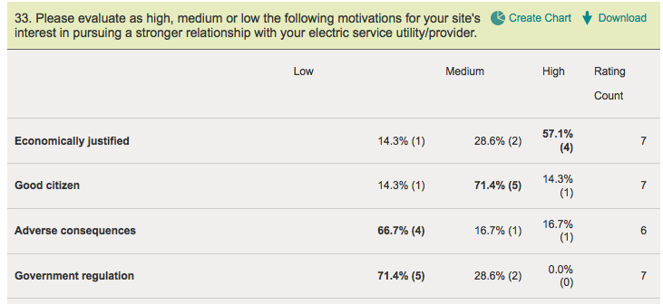
Motivation: Europe Only (New Question)
One no-response and one doesn't know
Highest → Lowest: economical, good citizen, adverse consequence, gov’t regulation

Slide 20
Methods
RENEWABLES
GRID SCALE STORAGE
FREQUENCY RESPONSE
REGULATION (Up or Down)
CONGESTION

Slide 21
Method Comparison Summary
Strong interest in renewables
Both European and US sites are interested in having communication with their providers about renewables
No discussion about methods
Neither European nor US sites have had communication with their electric providers about any of the other methods
Little interest
There is little interest in either European or US sites for communication about the other methods

Slide 22
Comments on Forecasting Demand
Our electricity contract specifies average expected usage and we announce planned changes.
We've to ensure that our power load neither over- nor undershoots the contracted power band. In any cases of foreseen power abnormalities we've to inform our grid provider at least two days ahead of schedule.
We project hourly average power at least a day in advance, within +/- 1MW
Information we’re being asked for but can’t provide:
Multi-year forecast of energy requirements.
Additional detailed forecasting and ultimately real time data.
Power projections, hour by hour, for at least a day in advance.
Demand forecasting is already required and/or requested

Slide 23
Comments on Provider Programs
EUROPE
There are not so many related options and features offered by providers. We are open to further and pro-active efforts as long as providers have other kinds of programs to propose
With many of your questions I am wondering about the kind of contracts other centers might have and about the quality of some electricity providers.
So far no such option from our suppliers
We would like to know if we could have time dependent pricing
UNITED STATES
Our site generates 30-35MW of power yet still imports 5-10MW. as a large generation source the utility providers see the campus as a highly attractive partner for offloading grid stress. automatic load shedding is being explored/deployed today.
Have talked to provider about the "Voluntary Option" to shed load during peak demand
We have explored load shed/shift in the past and shown it is do-able. Cultural resistance to impact on HPC productivity.
Working on load sharing of data with utility to provide better scheduling tools and address potential grid changes.
Evidence of more provider programs in the United States than Europe

Slide 24
Further Evidence: Fewer European Provider Programs
Number who answered
“Yes, they had conversations”
Program | Europe | United States
Peak Shedding | 1 | 6
Peak Shifting | 0 | 4
Dynamic Pricing | 0 | 5

Slide 25
Comments on Swings in Power
Working directly with provider to ensure that the effects of large load swings are understood. Have funded a simulation that accounts for all loads.
Our provider has no problem with our load swings. They indicate no concern with our next system either, but we are still looking into possible options in case there actually is a problem.
Sensitivity of power distribution grid to rapid transients (random daily step changes of 10 MW up or down within a single AC cycle).
US Sites investigating impact of power swings on distribution grid

Slide 26
Next Steps
Better understand European providers
Replicate in Japan

Slide 27
Back-up Detail

Slide 28
Respondent Demographics
Similar response rate; 9/16 (56%) respondents in Europe and 11/19 (58%) respondents in US
Top50 sites except for 1 in Europe and 2 in US
For US and Europe, the sampling was neither random nor anonymous
Relied on EE HPC WG membership contacts

Slide 29
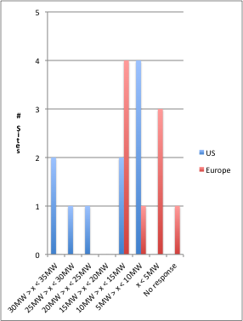
US and European Max Site Load
Again, 4 US sites max load 20+MW
Half of the sites max load between 5MW-15MW (11/20)
3 European and zero US sites less than 5MW max load

Slide 30
Tweaked Questions: Distinguishing Energy Efficiency and Grid Integration
European questions clearly separated energy efficiency from grid integration
Reminder: this question allows for multiple answers.
Yes, we do use coarse grained power management for energy efficiency
Yes, we do use coarse grained power management for responding to grid requests
No, we do not use coarse grained power management
We are interested in using coarse grained power management for energy efficiency
We are interested in using coarse grained power management for responding to grid requests
US questions blurred distinction between energy efficiency and grid integration
Yes, we do use coarse grained power management as a strategy for responding to grid requests.
Yes, we do use coarse grained power management as a strategy, but not for grid requests
No, we do not use a coarse grained power management strategy
No, but we could and might be interested in using it for grid requests or other purposes

Slide 31
Strategy Comparison Summary
Both Europe and US are using and/or interested in using some of these strategies for energy efficiency
Strategies with greatest use and/or interest: fine grain, job scheduling, lighting
US interest in coarse grain, but not Europe
There are not any sites in either the US or Europe who are using these strategies for grid integration
There is evidence that there are more US than European sites interested in using these strategies for grid integration
Strategies with greatest interest: coarse grain, fine grain, job scheduling, shut-down
Strategies with least interest: lighting, air temperature
Load migration is not interesting for either energy efficiency or grid integration

Slide 32
Coarse Grain
COARSE GRAINED POWER MANAGEMENT: refers to the ability to control SC system power and energy, but contrasts with fine-grained power management in that the resolution is low and it is generally done at a more aggregated level. A typical example is power capping.
Few European, but many US sites interested in coarse-grained power management (2/9 in Europe and 8/11 in US)

Slide 33
Comments: Coarse Grained
Europe
We manage to utilise our supercomputer to capacity and as such it is unclear to us how we could benefit from power management.
Slurm has a power capping mechanism - this could be used to block job scheduling beyond a certain level, in case we want to activate power capping
United States
Nothing is necessary at this time. Our provider has no problem with our load swings. They indicate no concern with our next system either, but we are still looking into possible options in case there actually is a problem.
We might be interested in the future when operating closer to our design limit and the maximum capacity of our utility feeders.
We have explored load shed/shift in the past and shown it is do-able. Cultural resistance to impact on HPC productivity.

Slide 34
Fine Grained and Job Scheduling Questions
FINE GRAINED POWER MANAGEMENT: refers to the ability to control SC system power and energy with tools that offer high resolution control and can target specific low level Subsystems. A typical example is CPU voltage and frequency scaling.
JOB SCHEDULING: refers to the ability to control SC system power by understanding the power profile of applications and queuing the applications based on those profiles.

Slide 35
Combining Job Scheduling and Fine Grained Responses
Fine grained power control mechanisms are being deployed in Job Schedulers
Same comment for both strategies
“We are using an energy-aware scheduling system which is able to automatically select the optimal processing frequency for applications to minimize the system energy needed to run the application to completion.”

Slide 36
Response: Job Scheduling/Fine Grained
Both European and US sites are using and/or interested in job scheduling and fine-grained power management (7/9 in Europe and 8/11 in US)
Many European and US sites are already using job scheduling and fine-grained power management for energy efficiency (5/9 in Europe and 6/11 in US)
Less interest in grid integration using fine-grained power management and job scheduling (1/9 in Europe and no more than 4/11 in US*)
* US Questionnaire asks for interest in “grid integration and other purposes”

Slide 37
Comments: Job Scheduling and Fine Grained Power Management
Europe
We are using an energy-aware scheduling system which is able to automatically select the optimal processing frequency for applications to minimize the system energy needed to run the application to completion.
New system end of this year is supposed to allow this
DVFS on Juropa
We have studied the impact of frequency tuning, and this can already be used by code developers but it is not fully deployed
United States
We implement de-clocking to shave up to 30% HPC power load to mitigate plant chiller issues should they occur
We have trouble with job scheduling for the basic purpose of queuing jobs to optimize the utilization of processors. I'd be interested in using it for energy efficiency, but don't believe the industry can satisfactorily support it. I would not be interested in this to reduce the utility grid demand.

Slide 38
Lighting Control
LIGHTING CONTROL Question: Data center lights could be turned off or shutdown completely
Both Europe and US sites are using and/or interested in using lighting control for energy efficiency (8/9 in Europe and 7/11 in US), but not for grid integration (zero in Europe and US)
European Comments
Our data center is operated as dark center. Hence most of the time the lights in the data center are out.
We do switch lights off when the room is empty but this is not a recognised strategy within our organisation.
United States Comments
Our lights automatically shut off 24x7 when there is no motion in the data center. This is so small compared to the HPC demand load that I'd be surprised if the utility is interested.
All data center lights are controlled by motion sensors.

Slide 39
Tweaked Air Control Question
European Version
INCREASING AIR TEMPERATURE: Increasing the temperature of the SC beyond the normal operating limit on a rapid, but temporary basis. For this question, consider the 'normal operating limit' to be set by the SC.
Note, this rapid and temporary excursion is different from the slow, deliberate and lasting increases in temperature that have been and continue to be a part of a continuous improvement process for energy efficiency purposes.
US Version
TEMPERATURE ADJUSTMENT: widen acceptable (ASHRAE Thermal Conditions) temperature set-point ranges and humidity levels for short periods.

Slide 40
Air Temperature Control
A few European and many US sites are using and/or interested in using air temperature control for energy efficiency (3/9 in Europe and 8/11 in US), but not for grid integration (zero in Europe and 1 in US)
European Comments
Over 90% of our HPC equipment is water cooled and therefore air temperature control would have minimal impact.
We did increase normal temperature - but so far we have not done that on a rapid / temporary basis (permanent setting)
United States Comments
Our normal inlet temp is 79F so there is little room for adjustment to save energy.
This is a challenge due to contractual obligations. It's easier to never deviate from specific temperature and humidity performance thresholds. We have set ours as high (temps) as possible, according to ASHRAE TC 9.9.
We implement de-clocking to shave up to 30% HPC power load to mitigate plant chiller issues should they occur

Slide 41
Liquid Control
Added a question for European sites about Liquid Cooling Temperature
3/9 use liquid cooling temperature control for energy efficiency
Comments:
We try to ensure the maximum water temperature at all times to make best use of our ambient air cooling system. We would not use this in response to demand side requests.
Our W4 cooling loop contains no chillers. We use the water temperature as provided by our whet cooling towers to cool the supercomputer.

Slide 42
Shut-down
SHUTDOWN: Graceful shutdown of idle HPC equipment loads. Usually applies when there is redundancy.
Only one European, but several US sites using and/or interested in using shut-down for energy efficiency and/or grid integration (1/9 in Europe and 5/11 in US)
COMMENTS:
Europe
There is nothing idle.
We had ONE exceptional use of shutdown for energy saving - not a regular practice
United States
We’ve had too many instability and equipment failures to utilize this as a strategy.

Slide 43
Load Migration
LOAD MIGRATION: refers to temporarily shifting computing loads from an SC system in one site to a system in another location that has stable power supply. This strategy can also be used in response to change in electricity prices.
No interest in load migration for energy efficiency or grid integration (0/9 in Europe and 1/11 in US)
COMMENTS:
Europe
We do not have a second facility to migrate work to.
United States
Outside of particular NSF funded systems, there are no distributed homogeneous HPC systems that we operate - preventing load migration.
We have only one grid available locally.
Facility is already fed by three diverse 161kV lines, and electrical distribution to the facility uses multiple diverse 13.8kV lines.

Slide 44
Back-up Resources
Using generators and other electrical storage devices.
Most sites do not use back-up resources (6/9 in Europe and 6/11 in US)
There is some interest in using back-up resources for energy efficiency, grid integration and other purposes (4/9 in Europe and 5/11 in the US)
COMMENTS:
Europe
We do not understand how using backup generation can improve energy efficiency. We have started to investigate the opportunities available with our supplier.
Our highly critical IT systems are backed-up by static UPS systems and a diesel generator. The HPC systems and all other not highly critical IT systems are only backed up by dynamic UPS systems with a maximum autonomy time of 20 s.
United States
The campus is leveraging parallel electrical distribution to trigger diesel generators and other back-up resources to respond to to grid and non-grid requests.
The cost of diesel generators is far higher than utility power, so we don't want to pursue this.
For some systems, we use rotary UPS to "ride through" power interruptions of up to 10-20s.
Use backup UPS for critical services, such as network, log in nodes, etc.

Slide 45
Back-up Scheduling
Refers to deferring data storage processes to off-peak periods.
Most sites do not use back-up scheduling (8/9 in Europe and 11/11 in US)
Interest in back-up scheduling for energy efficiency, grid integration or other purposes in US only (1/9 in Europe and 5/11 in US)
COMMENTS:
Europe
A significant degree of our storage utilises asyncronous IO techniques to overlay compute and IO in an efficient way.
United States

Slide 46
Cut Jobs
New question added to European questionnaire.
No interest in cutting jobs for either energy efficiency or grid integration (8/9 respondents)
Comment: we do not exactly cut jobs, we do have a 'time limit' setting mechanisms that can be considered more or less similar (gracefully terminates application) - moderate interest for potential other features

Slide 47
Other Strategies?
United States
Working on load sharing of data with utility to provide better scheduling tools and address potential grid changes.
Nothing is necessary at this time. Our provider has no problem with our load swings. They indicate no concern with our next system either, but we are still looking into possible options in case there actually is a problem.
We use water-side economizing via dry coolers. We could manually switch the sequence to use all the dry coolers and pre-cool or turn off a chiller. Our sequence of operations tries to do this automatically all the time based on an energy calculation. We can shut off N+1 equipment, taking the risk of start up time if the primary fails.
Working directly with provider to ensure that the effects of large load swings are understood. Have funded a simulation that accounts for all loads; the results of that simulation have been made available to provider.
Conduct preventative maintenance on HPC systems at end of summer months when peak power usage may be highest and used to set the month's power bill.
Controlled power reduction on request, by shutting down equipment, in cases of major power-related emergencies (very rare)
Europe
We've to ensure that our power load neither over- nor undershoots the contracted power band. In any cases of foreseen power abnormalities we've to inform our grid provider at least two days ahead of schedule.

Slide 48
What you’d like to know
Is there information you would like from your provider that you are not getting?
Europe
We would like to know if we could have time dependent price.
We are open to new features our provider(s) might offer
Not at present but we have not engaged sufficiently with our supplier as yet.
United States
Yes, we are working on obtaining additional data from them and a means of sharing data between them and us.
Sensitivity of power distribution grid to rapid transients (random daily step changes of 10 MW up or down within a single AC cycle).
I'd like detailed information about disruptions and power quality from their perspective. Occasionally, we'll experience a brown out that automatically transfers us to generator power, but the utility provides no information on the root cause or what actually happened.
Notes:
This was one of the last questions we asked, but it captures a kind of summary of the results. You would like to know more about programs that might save you money and you’d like to understand the impact of ultra-fast large power swings. When there is a power quality issue, you’d also like to know the root cause.

Slide 49
What you’re being asked for
Is your provider asking for information from you that you are not able to provide?
Europe
Multi-year forecast of energy requirements.
United States
Additional detailed forecasting and ultimately real time data.
Power projections, hour by hour, for at least a day in advance.
Notes:
Moving on to what information you’re being asked for by your provider, it is a consistent request to forecast demand. For some in the United States, that forecast request is fine-grained and short term.

Slide 50
Electricity Provider Introduction
Help us to understand the nature of the relationship you have, if any, between your HPC facility and your site's electric utility/provider.
Have had any communication about the following programs and methods with your site’s electric utility/provider.
Please describe the nature of that communication in the comments.

Slide 51
Programs
PEAK SHEDDING
PEAK SHIFTING
DYNAMIC PRICING

Slide 52
Program Comparison Summary
Neither European nor US sites are engaged with peak shedding, peak shifting or dynamic pricing programs
There are more US than European sites who have communicated with their utility providers about these types of programs
The Europeans sites are not interested in peak shifting, although there is some interest in peak shedding and dynamic pricing
The US sites are slightly more interested in peak shifting than peak shedding and dynamic pricing

Slide 53
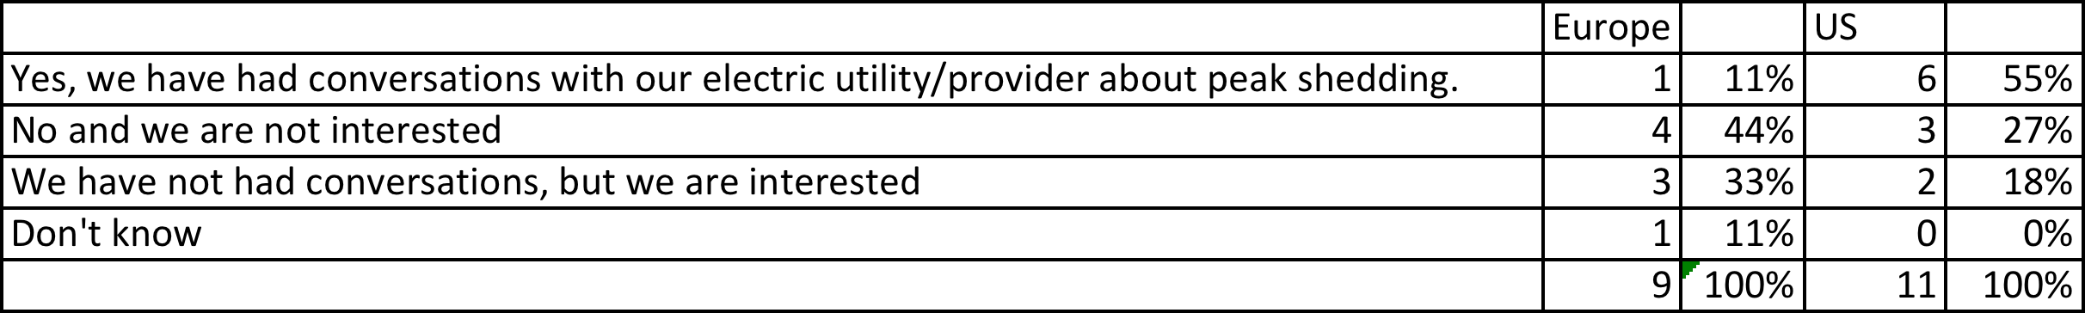
Peak Shedding
Utility provider arrangements used to reduce peak load, where the reduced load is not shifted to another time.
Only one European but many US sites have had conversations about peak shedding with their utility provider
Of those who have not had conversations, there are slightly more who are NOT interested than those who are interested in both Europe and US

Slide 54
Comments: Peak Shedding
Europe
Currently not an issue for us.
We are starting to consider the implications of this type of strategy and are fully aware that it needs to be carefully evaluated.
So far no such option from our suppliers
United States
UCSD generates 30-35MW of power yet still imports 5-10MW. as a large generation source the utility providers see the campus as a highly attractive partner for offloading grid stress. automatic load shedding is being explored/deployed today.
Have talked to PG&E subcontractor about he "Voluntary Option" to shed load during peak demand days.
Our load is typically very steady daily and monthly, so this doesn't make sense. We would be sacrificing compute cycles.
Not currently necessary.
Technical feasibility has yet to be developed. Business case has yet to be developed.

Slide 55

Peak Shifting
Utility provider arrangements where the load during peak times is moved, typically to non-peak hours.
Europe predominately NOT interested in peak shifting and have not had communication with their utility provider, but several US sites have had discussions and/or are interested

Slide 56
Comments: Peak Shifting
Europe
Currently not an issue for us.
The reason we have a high HPC utilisation is that it is the only mechanism to accommodate our workload, we lack spare capacity to move work to "off peak" periods.
So far no such option from our suppliers
United States
Not to move to non-peak hours. We have one rate, we do not have off-peak and on-peak rates.
Our load is typically very steady due to job scheduling, so this doesn't make sense in most 24 hour cycles.
Not currently necessary.
Have talked to PG&E subcontractor about he "Voluntary Option" to shed load during peak demand days.
Technical feasibility has yet to be developed. Business case has yet to be developed.

Slide 57
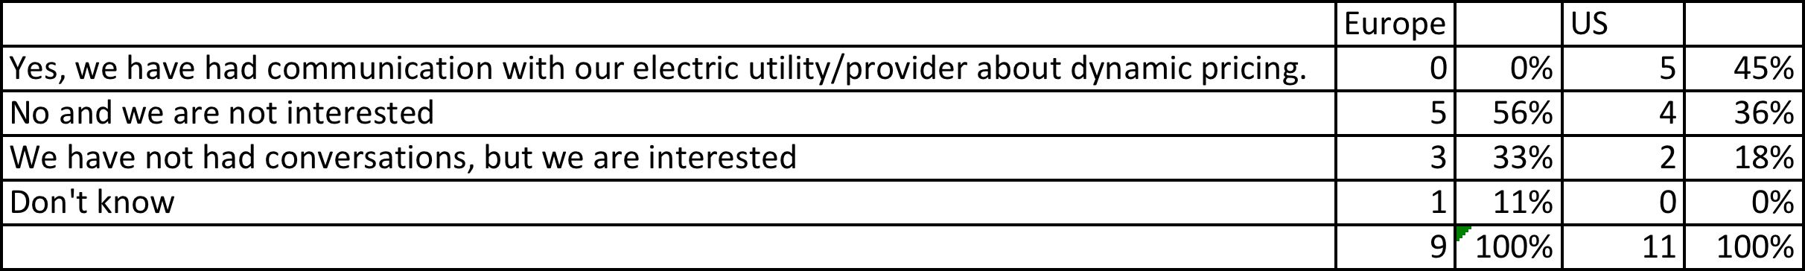
Dynamic Pricing
Time varying pricing arrangements used to increase, shed or shift electricity consumption. There are two types of pricing, peak and real-time. Peak pricing is pre-scheduled; however, the consumer does not know if a certain day will be a peak or a non-peak day until day-ahead or day-of. Real-time pricing is not pre-scheduled; prices can be set day-ahead or day-of.
Europe predominately NOT interested in dynamic pricing and have not had communication with their utility provider
Many US sites have had discussions
Of the US sites who have not had communication, there are many who are not interested

Slide 58
Comments: Dynamic Pricing
Europe
Currently not an issue for us.
So far no such option from our suppliers
United States
Mis forecasts could lead to sale of power at higher than purchase price and can be an issue for profit to the National Treasury.
Pricing based on our generation/consumption to the best of my knowledge is generally fixed.
Our Utilities group is negotiating prices on a continuing basis, daily, I believe.
Not currently implemented.
The pricing arrangement is done at the base level where we are located and not by our organization.
Project hourly average power for at least a day in advance, within +/- 1MW

Slide 59
Methods
RENEWABLES
GRID SCALE STORAGE
FREQUENCY RESPONSE
REGULATION (Up or Down)
CONGESTION

Slide 60
Method Comparison Summary
Both European and US sites are interested in having communication with their providers about renewables
Neither European nor US sites have had communication with their electric providers about any of the other methods
There is little interest in either European or US sites for communication about the other methods

Slide 61
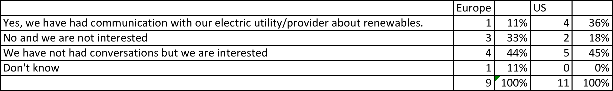
Renewables
Variability in the electric power generation from renewable resources and the methods used to respond to that variability
Many more US than European sites have had communication with their electric utility/provider about renewables
Both European and US sites are interested in having this discussion

Slide 62
Comments: Renewables
Europe
We've signed a power contract for 100% renewable energy (mainly electricity from hydroelectric power stations).
So far no such option from our suppliers.
Currently not an issue for us.
United States
At the Institutional level not just for HPC.
The campus has a large fuel cell (2.5+ MW) and works with the utility with renewables.
We looked for green power sources as part of LEED certification. The cost was unsustainable.
Provider already uses multiple sources (hydroelectric, nuclear, natural gas, coal, wind). Further use of renewables would be of interest.
Variability in power generation is beyond our control or visibility. Utilities and power grid operators see this, we don't.

Slide 63

Grid Scale Storage
Methods used to store electricity on a large scale. Pumped-storage hydroelectricity is the largest-capacity form of grid energy storage.
Neither US nor European sites have had communication with their electric utility/providers about grid scale storage
Many more US than European sites are interested in having this discussion

Slide 64
Comments: Grid Scale Storage
Europe
Currently not an issue for us.
United States
At the Institutional level not just for HPC.
We are interested in technical options for energy storage on time scales of a single AC cycle to several hours, at 10 MW+ scale. We are less concerned about energy storage at time scales of hours to days.

Slide 65
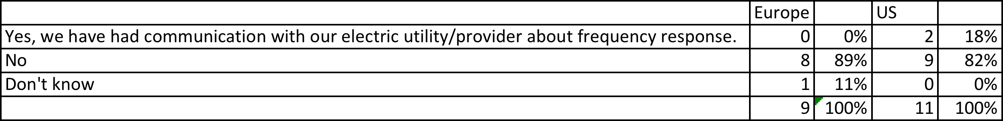
Frequency Response
Methods used to keep grid frequency constant and in-balance. Generators are typically used for frequency response, but any appliance that operates to a duty cycle (such as air conditioners and heat pumps) could be used to provide a constant and reliable grid balancing service by timing their duty cycles in response to system load.
Neither US nor European sites have had communication with their electric utility/provider about frequency response.

Slide 66
Comments: Frequency Response
Europe
We are not large enough to have an impact on the local grid by using such mechanisms. The only option for us is to run on local generation which would not be particularly responsive to frequency shifts. As a consequence of utilizing diesel rotary UPS machines on our site we do have automatic on-site generation that operates when frequency fluctuations of more than 0.5Hz occur.
So far no such option from our suppliers.
Currently not an issue for us.
United States
Again, this isn't visible to us nor controllable by us; this is a power grid regulation problem.
Not sure.

Slide 67
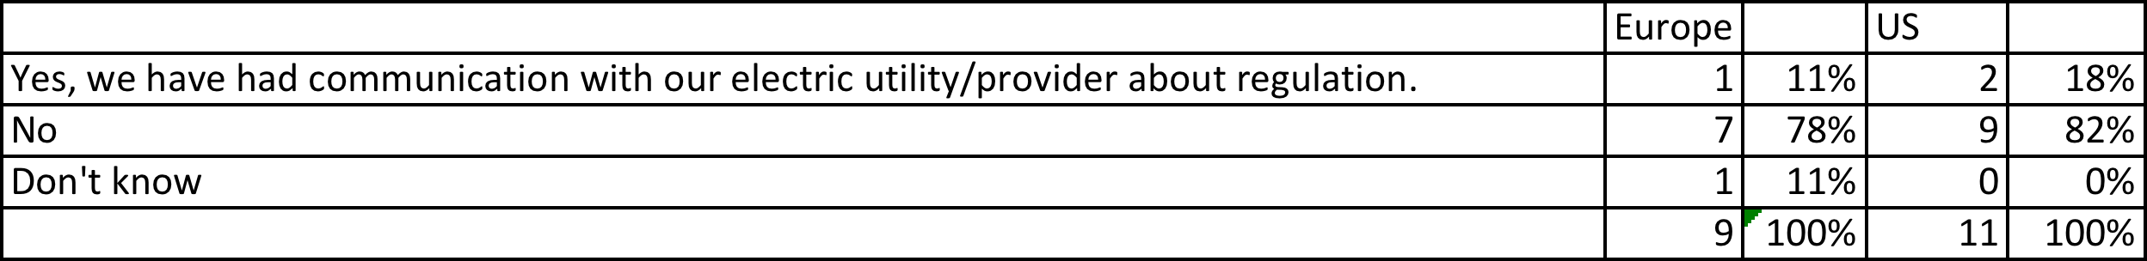
Regulation
(Up or Down): Methods used to maintain that portion of electricity generation reserves that are needed to balance generation and demand at all times. Raising supply is up regulation and lowering supply is down regulation. There are many types of reserves (e.g., operating, congestion), distinguished by who controls them and what they are used for.
Similar to frequency response, very few US or European sites have had communication with their electric utility/provider about regulation.

Slide 68
Comments: Regulation
Europe
We've to ensure that our power load neither over- nor undershoots the contracted power band. In any cases of foreseen power abnormalities we've to inform our grid provider at least two days ahead of schedule.
Currently not an issue for us.
United States
Learning about the process outside of our visibility or control.
Not sure.

Slide 69
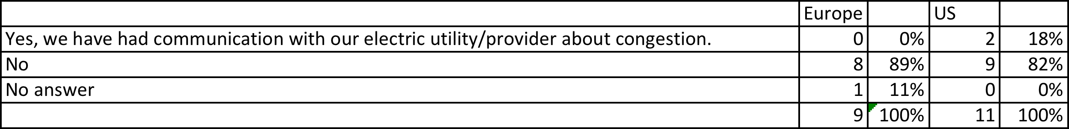
Congestion
Methods used to resolve congestion that occurs when there is not enough transmission capability to support all requests for transmission services. Transmission system operators must re-dispatch generation or, in the limit, deny some of these requests to prevent transmission lines from becoming overloaded. Or, methods used to resolve congestion that occurs when the distribution control system is overloaded. It generally results in deliveries that are held up or delayed.
Identical to frequency response, very few US or European sites have had communication with their electric utility/provider about congestion.

Slide 70
Comments: Congestion
Europe
Not an issue for us - big line, dedicated
Currently not an issue for us.
United States
Learning about the process outside of our visibility or control.
Not sure.

Slide 71
Motivation: Europe Only (New Question)
One no-response and one don't know

Slide 72
Power Quality Issues
Do you experience any power quality issues at your HPC facility?
Europe
Occasional brown-outs due to strong thunder storm activity. Within expected and acceptable range for us.
We never have a problem with our HPC facility.
Yes, we observed several lightning induced brown outs during 2013
Very good quality of power we thus dismissed most of UPSs, having instead compute blades with ultracapacitors to handle subt-second power outages Only some critical equipment is protected with UPSs (<20%) observed short outages (~300 ms), handled by UltraCapas, are ~5 Times a year
United States.
No, only when there is a glitch.
We have had brown outs and a few other things. We condition our power to our systems now, so the major issue is if we have a power outage.
We have clean, relatively reliable power to the area with an additional feed from campus power plant available.
Under voltage incidents (brown outs) have been rare, but had significant impact. We've had only one complete loss of power in 13 months since moving onto a dedicated, buried feeder line from a new substation that is dedicated to this industrial park.

Slide 73
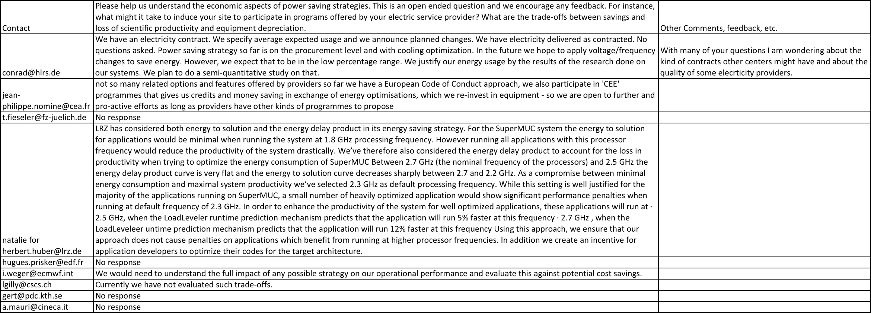
Final Open-ended Questions
Notes:
Conrad from Denmark would like to see the results.
Interesting discussion from LRZ.

Slide 74
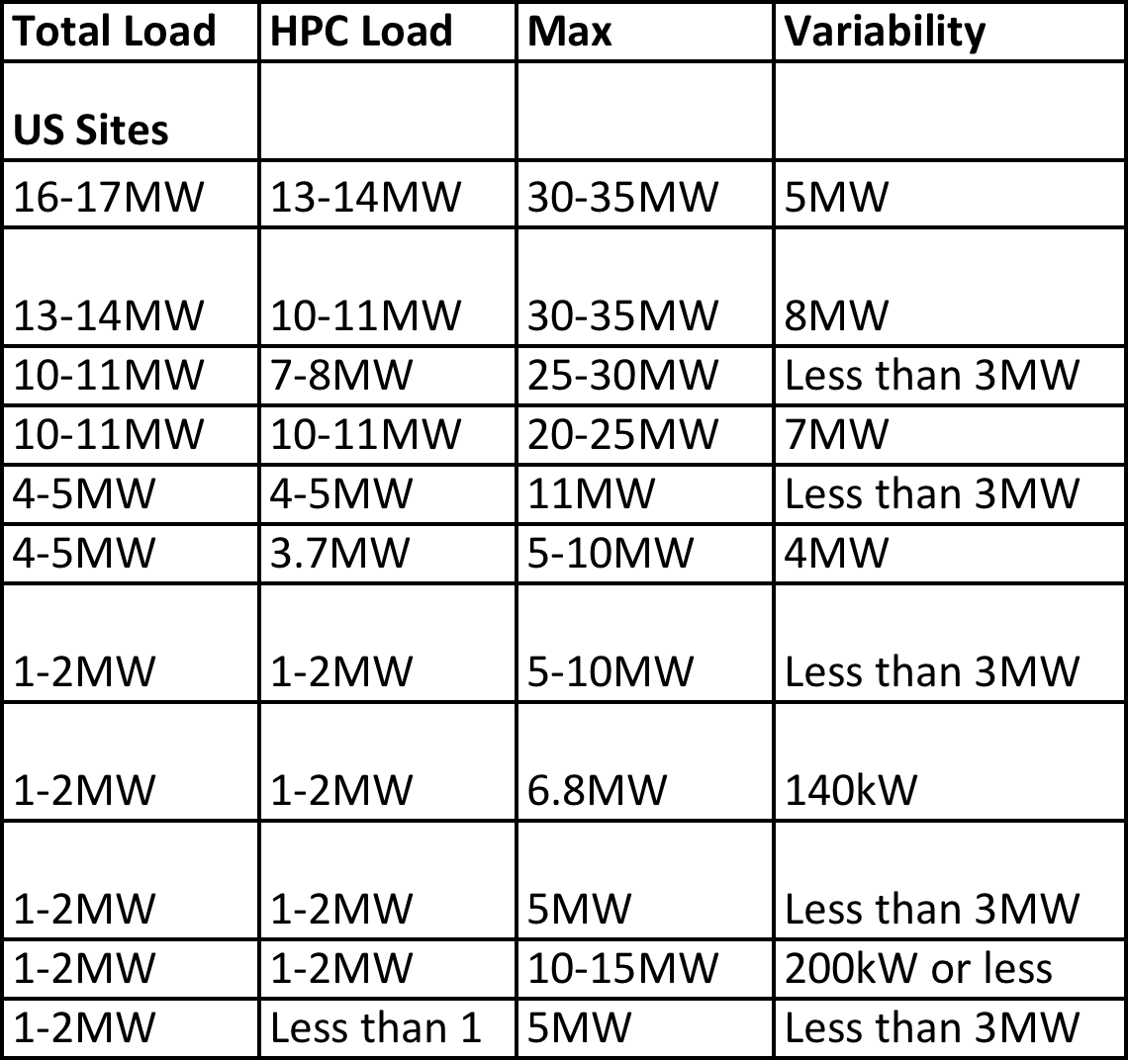
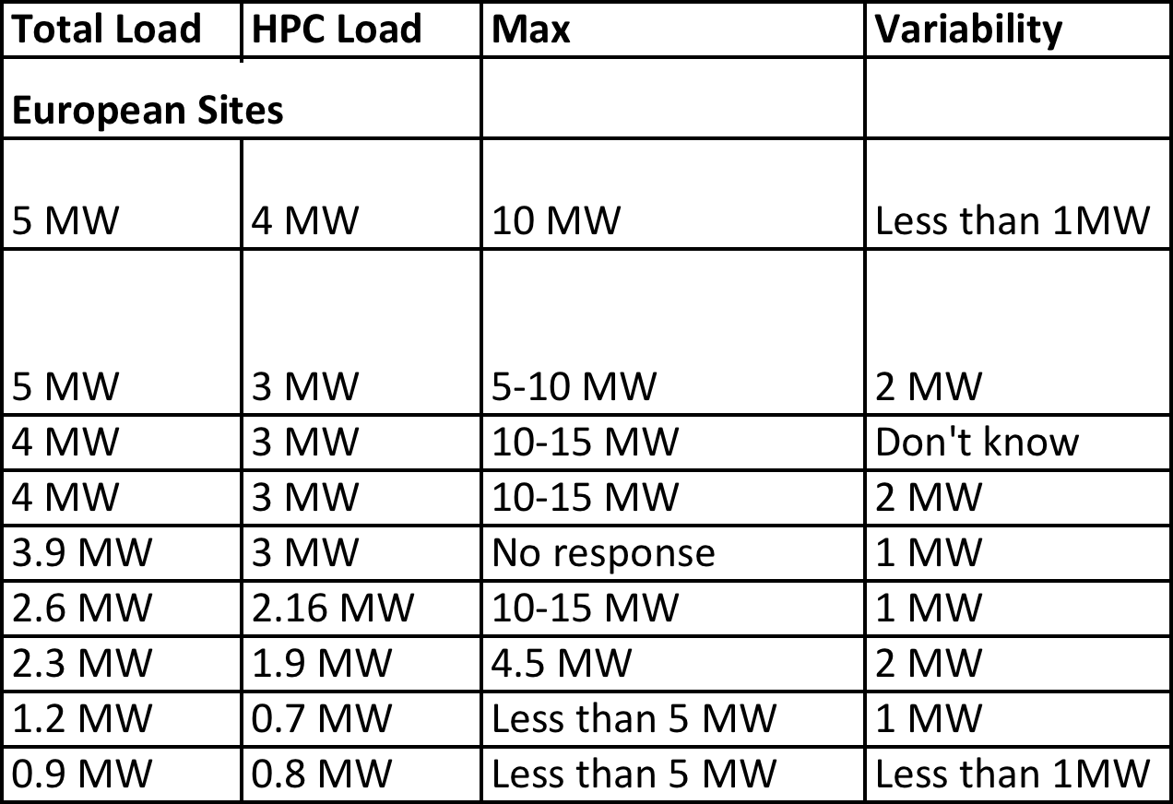
US and European Facility Detail

Slide 75
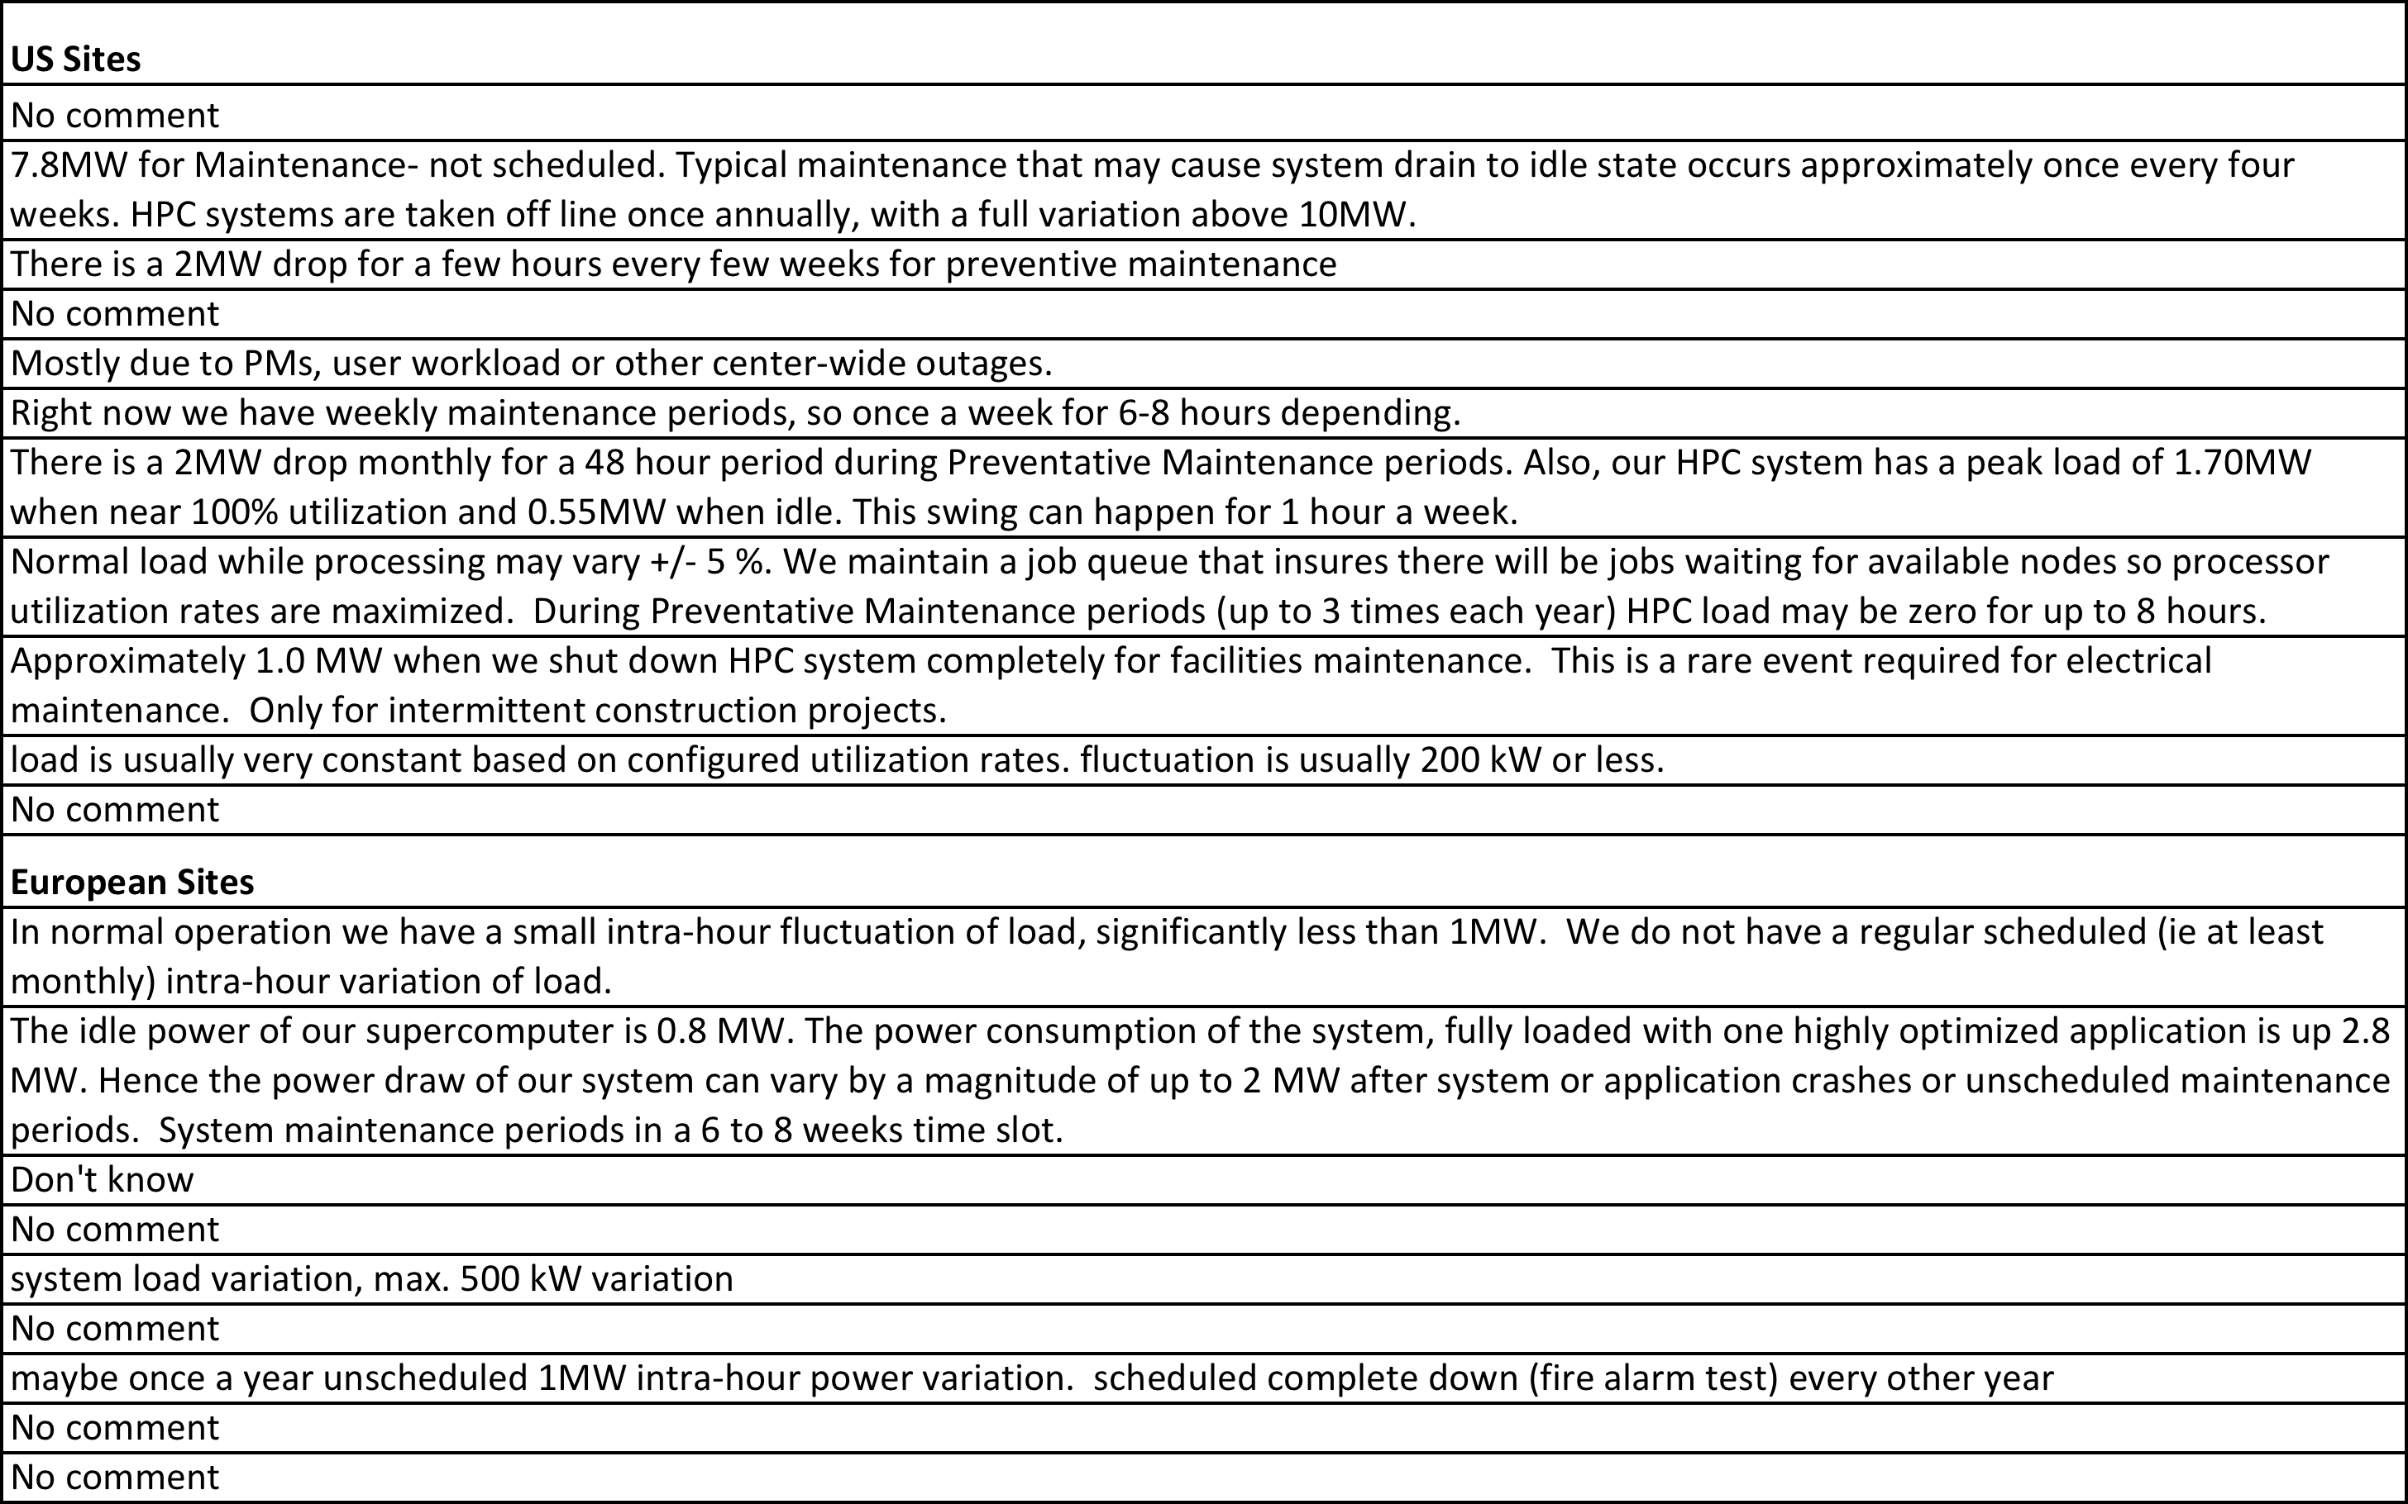
Intra-hour Variability Comment Detail

Slide 76
